Slide 1
CADC On-line Taxes
Did you know you can file a FREE federal and state return if
your income in 2020 was $72,000 or less?
Easy Q&A guidance to fill out the 1040 form
No age restrictions
EFile service for federal and Oklahoma returns
Supports Form 1040NR
View and print tax returns
Do you have any questions about your return? Our certified tax coaches can help!
Contact us via Email: lvardell@pldi.net
Assistors will be answering questions Monday-Friday, 8:00 am – 5:00 pm
Responses provided within 24 hours operation days
The First Step: To e-file your 2020 tax return, you must verify your identity with your Adjusted Gross Income from your 2019 tax return via the link below.
Validate Identity
Civil Rights
Interactive Tax Assistant
EITC Assistant
Federal Student Financial Aid (FAFSA)
Where’s My Refund

Slide 3
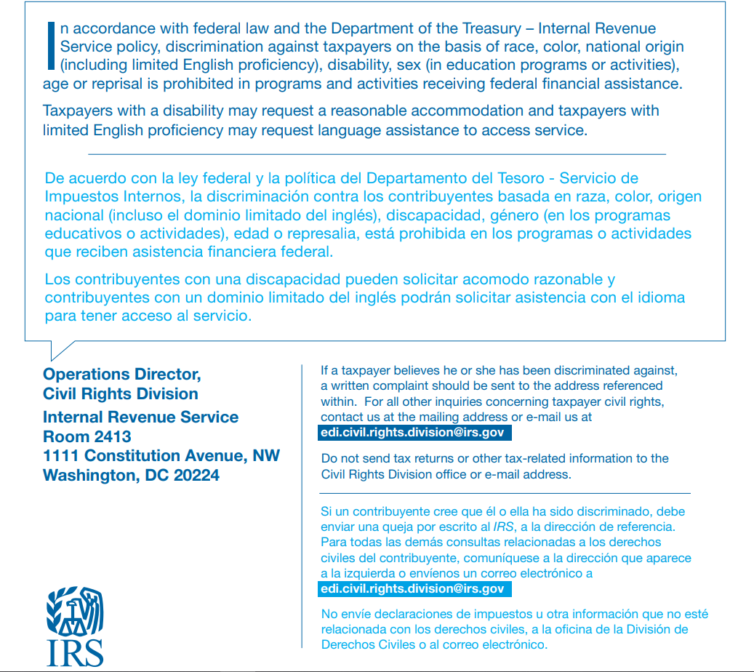

Slide 4
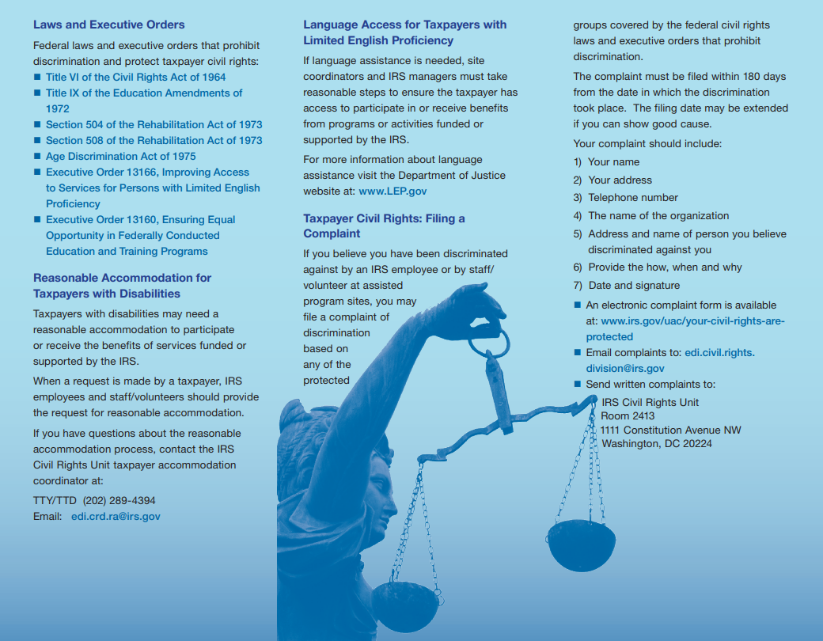

Slide 5
